Slide 1
Heaps and heapsort
COMP171
Fall 2005
Part 2

Slide 2
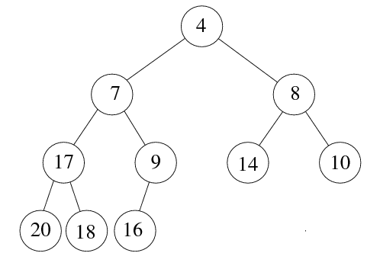

Heap: array implementation
1
2
3
5
6
7
4
8
9
10
Is it a good idea to store arbitrary binary trees as arrays? May have many empty spaces!

Slide 3
Array implementation
The root node is A[1].
The left child of A[j] is A[2j]
The right child of A[j] is A[2j + 1]
The parent of A[j] is A[j/2] (note: integer divide)
1
1
2
5
4
3
6
2
5
4
3
Need to estimate the maximum size of the heap.
6

Slide 4
Heapsort
(1) Build a binary heap of N elements
  the minimum element is at the top of the heap
(2) Perform N DeleteMin operations
  the elements are extracted in sorted order
(3) Record these elements in a second array and then copy the array back

Slide 5
Heapsort – running time analysis
(1) Build a binary heap of N elements
  repeatedly insert N elements ⇒ O(N log N) time
  (there is a more efficient way)
(2) Perform N DeleteMin operations
  Each DeleteMin operation takes O(log N) ⇒ O(N log N)
(3) Record these elements in a second array and then copy the array back
  O(N)
Total: O(N log N)
Uses an extra array

Slide 6
Heapsort: no extra storage
After each deleteMin, the size of heap shrinks by 1
  We can use the last cell just freed up to store the element that was just deleted
  ⇒ after the last deleteMin, the array will contain the elements in decreasing sorted order
To sort the elements in the decreasing order, use a min heap
To sort the elements in the increasing order, use a max heap
  the parent has a larger element than the child

Slide 7
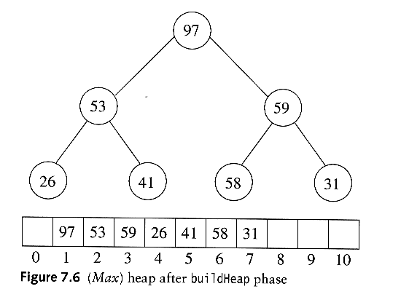
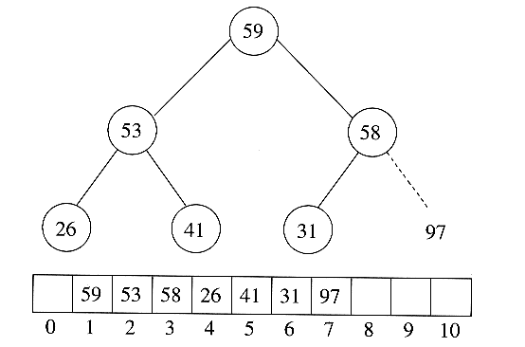
Heapsort
Sort in increasing order: use max heap
Delete 97

Slide 8
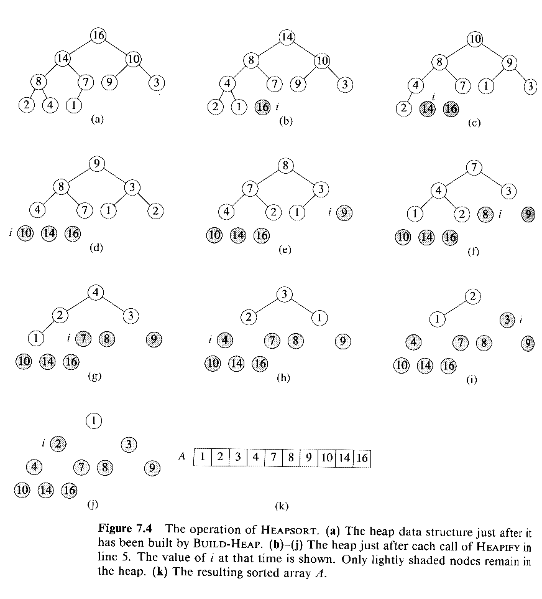
Heapsort: A complete example
Delete 16
Delete 14

Slide 9
Example (cont’d)
Delete 10
Delete 9
Delete 8

Slide 10
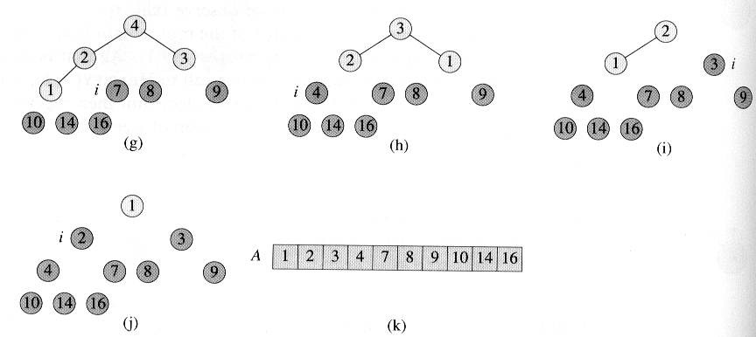
Example (cont’d)

